Slide 1
HVDC Light Power Flow Modelling
Saad Masood 2018-MS-EE-02
Muhammad Shamaas 2018-MS-EE-04
Muhammad Zawar Hasan 2018-MS-EE-06
Muhammad Umer Arshad 2018-MS-EE-07

Slide 2
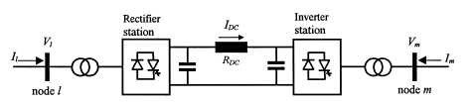
INTRODUCTION
HVDC Light converters include Insulated Gate Bipolar Transistors (IGBTs) and operate with high frequency Pulse Width Modulation (PWM) in order to get high speed control of both active and reactive power.
The HVDC light comprises two voltage source converter (VSC), one operating as a rectifier and the other operating as inverter.
Its main function is to transmit constant dc power from rectifier to inverter station.

Slide 3
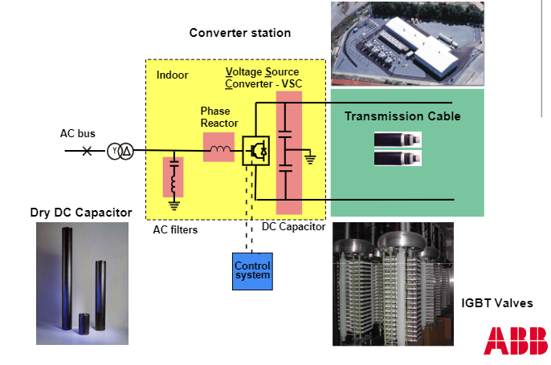
HVDC Light – Building Blocks
HVDC Light consists of:
Standard Power Transformers: regulate AC voltage for VSC operation.
AC Filters: provide low impedance paths for the harmonics to ground.
Voltage Source Converters: self-commutated IGBT valve stacks operating with high frequency Pulse Width Modulation (PWM).
DC side capacitor: provides a low inductance path for the turned off current and reduces the harmonic ripple.
DC transmission: achieved using power lines, submarine DC cables or Long Distance Overhead Lines.
Converter Reactors: provide low-pass filtering of the Inverter output PWM pattern.

Slide 4
Evolution of HVDC Light
High voltage direct current transmission: based on solid state voltage source technology. It utilizes most advanced power electronics and semiconductors.
Advanced control features: black-start capability, islanding, power system stabilization, improved remote support, enhanced cyber security protection, dedicated support functions and facilities, asset health systems and harmonic suppression.
2-Level HVDC Light Generation 3 VSC technology: World’s most powerful VSC project. It uses a significantly smaller site area than an equivalent-rated Line Commutated Converter HVDC project. This is at the expense of increased converter building size and higher losses.

Slide 5
Operational Issues
If large on- or offshore grids develop, then different manufacturers will be connecting their converters to the same DC network.
Key HVDC Light issues: modular multi-terminal control, protection, reliability, and cable modelling and design.
DC Circuit Breakers: AC circuit breakers cannot be used in HVDC systems because it would involve time consuming de-energizing and re-energizing of DC system.
Over-voltages: One potential challenge faced by the cable system is new type of over-voltages occurring in the dc cable due to faults in the HVDC system, system topology and converter design.

Slide 6
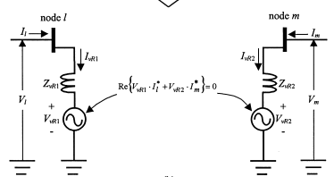
Equivalent HVDC Light Model
Rectifier is connected to bus l using Zr. It draws desired power from bus l by regulating bus l voltage.
Inverter is connected to bus m using Zi. Inverter delivers desired active power and absorbs desired reactive power.
The converters are lossless hence no active power is consumed by converters.

Slide 7
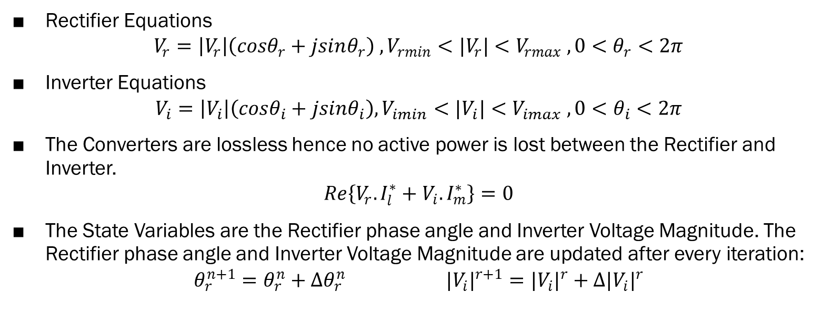
HVDC Model Equations
Rectifier Equations
$$V_{r}=\left|V_{r}\right|\left(cosθ_{r}+jsinθ_{r}\right) , V_{rmin}<{|V}_{r}|<V_{rmax} , 0<θ_{r}<2π$$
Inverter Equations
$$V_{i}=\left|V_{i}\right|\left(cosθ_{i}+jsinθ_{i}\right), V_{imin}<{|V}_{i}|<V_{imax} , 0<θ_{i}<2π$$
The Converters are lossless hence no active power is lost between the Rectifier and Inverter.
$$Re\left\{V_{r}.I_{l}^{∗}+V_{i}.I_{m}^{∗}\right\}=0$$
The State Variables are the Rectifier phase angle and Inverter Voltage Magnitude. The Rectifier phase angle and Inverter Voltage Magnitude are updated after every iteration:
$$θ_{r}^{n+1}=θ_{r}^{n}+{∆θ}_{r}^{n} {|V_{i}|}^{r+1}={|V_{i}|}^{r}+{∆|V_{i}|}^{r}$$

Slide 8
5 Bus Model Power Flow Solution

Slide 9
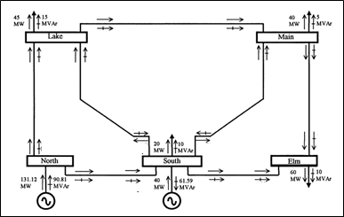
5 Bus Model Power Flow Solution using Newton Raphson
Information | North | South | Lake | Main | Elm
|V| (p.u.) | 1.06 | 1.00 | 0.987 | 0.984 | 0.972
Θ (degrees) | 0.00 | -2.06 | -4.64 | -4.96 | -5.76
P (p.u.) | 1.311 | 0.200 | -0.450 | -0.400 | -0.600
ΔP (p.u.) |  | -1.64e-13 | -4.51e-14 | -1.88e-14 | 2.63e-14
Q (p.u.) | 0.908 | -0.716 | -0.150 | -0.050 | -0.100
ΔQ (p.u.) |  | 0.616 | -1.613e-13 | -3.393e-14 | 7.780e-14

Slide 10
5 Bus Model Power Flow Solution using Newton Raphson

Slide 11
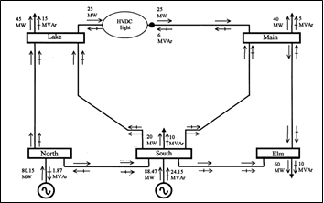
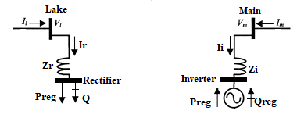
5 Bus Model with HVDC Light
Inverter is connected to Main using Zi. Inverter is modeled as a PV node to deliver desired active power Preg=0.25 p.u. and absorb desired reactive power Qreg=-0.06 p.u.
Rectifier is connected to Lake using Zr. Rectifier is modeled as a PQ node to draw desired power Preg=0.25 p.u. from Lake. The voltage of Lake node |V_{l}| is regulated at 1 p.u.

Slide 12
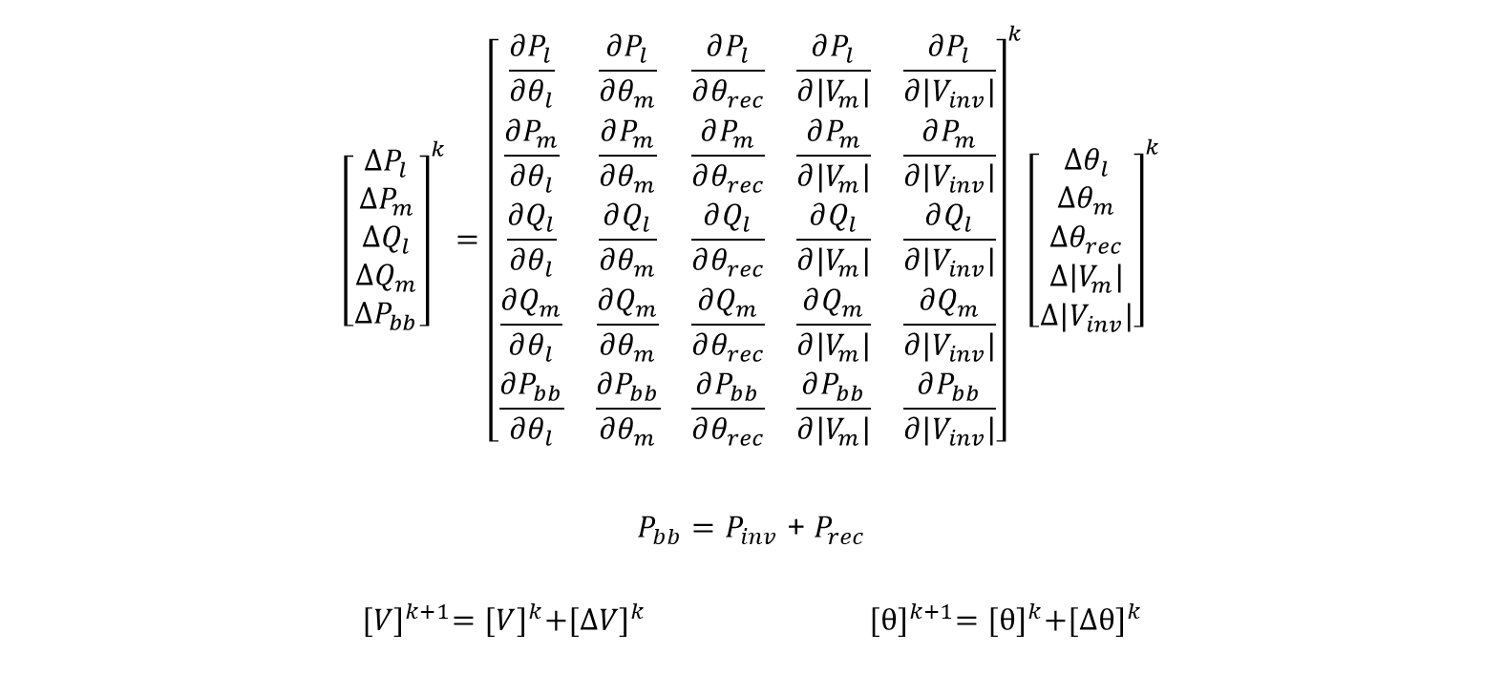
Newton Raphson Method
$${\left[\begin{matrix}∆P_{l} \\ ∆P_{m} \\ \begin{matrix}∆Q_{l} \\ {∆Q}_{m} \\ ∆P_{bb}\end{matrix}\end{matrix}\right]}^{k}={\left[\begin{matrix}\frac{∂P_{l}}{∂θ_{l}} & \frac{∂P_{l}}{∂θ_{m}} & \begin{matrix}\frac{∂P_{l}}{∂θ_{rec}} & \frac{∂P_{l}}{∂|V_{m}|} & \frac{∂P_{l}}{∂|V_{inv}|}\end{matrix} \\ \frac{∂P_{m}}{∂θ_{l}} & \frac{∂P_{m}}{∂θ_{m}} & \begin{matrix}\frac{∂P_{m}}{∂θ_{rec}} & \frac{∂P_{m}}{∂|V_{m}|} & \frac{∂P_{m}}{∂|V_{inv}|}\end{matrix} \\ \begin{matrix}\frac{∂Q_{l}}{∂θ_{l}} \\ \frac{∂Q_{m}}{∂θ_{l}} \\ \frac{∂P_{bb}}{∂θ_{l}}\end{matrix} & \begin{matrix}\frac{∂Q_{l}}{∂θ_{m}} \\ \frac{∂Q_{m}}{∂θ_{m}} \\ \frac{∂P_{bb}}{∂θ_{m}}\end{matrix} & \begin{matrix}\begin{matrix}\frac{∂Q_{l}}{∂θ_{rec}} \\ \frac{∂Q_{m}}{∂θ_{rec}} \\ \frac{∂P_{bb}}{∂θ_{rec}}\end{matrix} & \begin{matrix}\frac{∂Q_{l}}{∂|V_{m}|} \\ \frac{∂Q_{m}}{∂|V_{m}|} \\ \frac{∂P_{bb}}{∂|V_{m}|}\end{matrix} & \begin{matrix}\frac{∂Q_{l}}{∂|V_{inv}|} \\ \frac{∂Q_{m}}{∂|V_{inv}|} \\ \frac{∂P_{bb}}{∂|V_{inv}|}\end{matrix}\end{matrix}\end{matrix}\right]}^{k}{\left[\begin{matrix}∆θ_{l} \\ ∆θ_{m} \\ \begin{matrix}∆θ_{rec} \\ ∆|V_{m}| \\ ∆|V_{inv}|\end{matrix}\end{matrix}\right]}^{k}$$
$P_{bb}=P_{inv}$ + $P_{rec}$
$${[V]}^{k+1}={[V]}^{k}+{[ΔV]}^{k} {[θ]}^{k+1}={[θ]}^{k}+{[Δθ]}^{k}$$

Slide 13
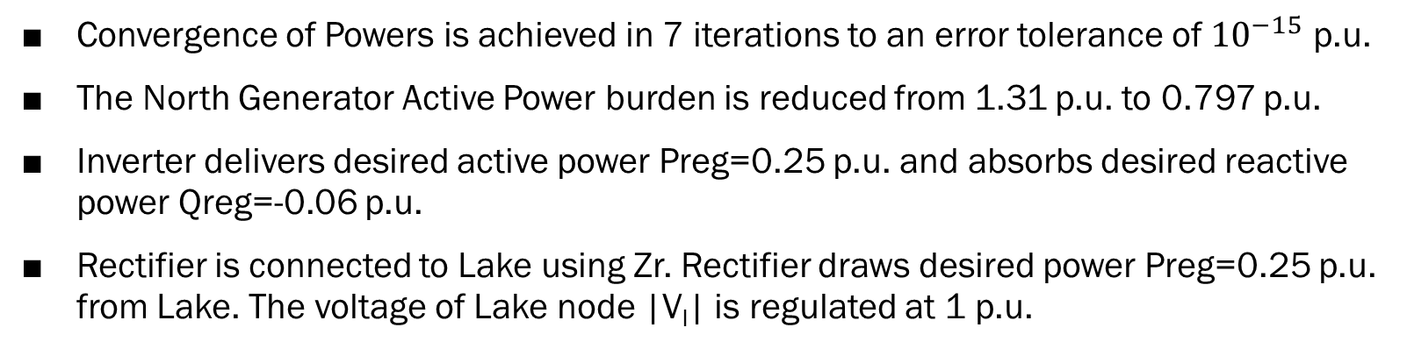
Results of 5 Bus Model with HVDC Light
Information | North | South | Lake | Main | Elm | Rectifier | Inverter
|V| (p.u.) | 1.036 | 1.029 | 1.000 | 1.003 | 0.998 | 1.005 | 1.006
Θ (degrees) | 0.00 | -1.41 | -4.64 | -3.55 | -4.72 | 6.20 | -2.50
P (p.u.) | 0.7978 | 0.6789 | -0.4397 | -0.400 | -0.600 | -0.251 | 0.250
ΔP (p.u.) |  | 0.0058 | -0.0103 | -1.44e-15 | -1.22e-15 | 0.00104 | 4.44e-16
Q (p.u.) | -0.029 | 0.1736 | -0.120 | -0.050 | -0.100 | -0.031 | -0.06
ΔQ (p.u.) |  | -0.2736 | -0.0302 | -8.17e-15 | 4.96e-15 | 0.0305 | 2.28e-15
Convergence of Powers is achieved in 7 iterations to an error tolerance of ${10}^{−15}$ p.u.
The North Generator Active Power burden is reduced from 1.31 p.u. to 0.797 p.u.
Inverter delivers desired active power Preg=0.25 p.u. and absorbs desired reactive power Qreg=-0.06 p.u.
Rectifier is connected to Lake using Zr. Rectifier draws desired power Preg=0.25 p.u. from Lake. The voltage of Lake node |V_{l}| is regulated at 1 p.u.

Slide 14
Convergence of Bus Voltages and Powers

Slide 15
Regulated VSC Active and Reactive Powers

Slide 16
IEEE 14 Bus System Power Flow Solution

Slide 17
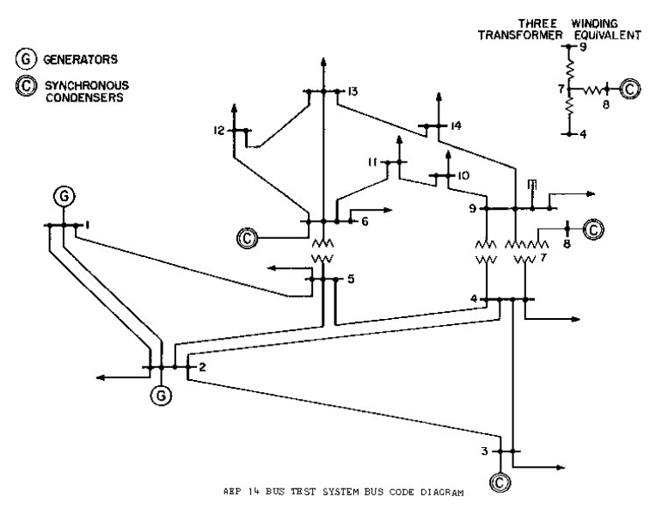
IEEE 14 Bus System
The system consists of
14 buses
2 generators
3 synchronous condensers
11 loads
3 transformers (3 phase shifters)
The Generators and Synchronous condensers can deliver active and reactive powers for regulating constant voltage magnitudes at their respective buses.

Slide 18
IEEE 14 Bus Model Power Flow Solution using Newton Raphson
Information | 1 | 2 | 3 | 4 | 5 | 6 | 7 | 8 | 9 | 10 | 11 | 12 | 13 | 14
|V| (p.u.) | 1.060 | 1.060 | 1.060 | 1.048 | 1.048 | 1.060 | 1.040 | 1.060 | 1.024 | 1.024 | 1.039 | 1.049 | 1.043 | 1.021
Θ (degrees) | 0.00 | -6.44 | -15.8 | -13.1 | -11.2 | -17.1 | -16.3 | -16.3 | -18.1 | -18.5 | -18.1 | -18.6 | -18.9 | -20.3
P (p.u.) | 2.44 | 0.183 | -0.942 | -0.478 | -0.076 | -0.112 | 0 | 0 | -0.295 | -0.090 | -0.035 | -0.061 | -0.135 | -0.149
ΔP (p.u.) |  | 6e-16 | -3e-15 | -4e-15 | 5e-16 | 2e-15 | -8e-16 | 1e-16 | -6e-15 | 1e-15 | -5e-16 | -6e-16 | -3e-16 | 4e-16
Q (p.u.) | 0.213 | 0.309 | 0.119 | 0.039 | -0.016 | 0.274 | 0 | 0.123 | -0.166 | -0.058 | -0.018 | -0.016 | -0.058 | -0.050
ΔQ (p.u.) |  | -0.01 | -0.075 | 4e-15 | -6e-15 | -0.227 | 0 | 0.050 | 3e-15 | -1e-15 | 6e-16 | 9e-16 | -1e-15 | -2e-15
Convergence of Powers is achieved in 7 iterations to an error tolerance of ${10}^{−15}$ p.u.
All Bus, Generator and Synchronous Condenser Voltage and Power Limits are met.

Slide 19
Convergence of Bus Voltages and Powers

Slide 20
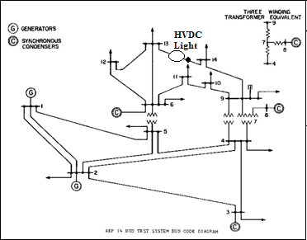
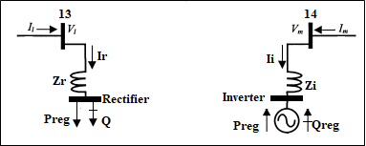
IEEE 14 Bus System with Book HVDC Light Model
Rectifier is connected to bus 13 to draw desired power Preg=0.25 p.u. The voltage of bus 13 is regulated at 1.06 p.u.
Inverter is connected to bus 14 to deliver desired active power Preg=0.25 p.u. and absorb desired reactive power Qreg=-0.06 p.u.

Slide 21
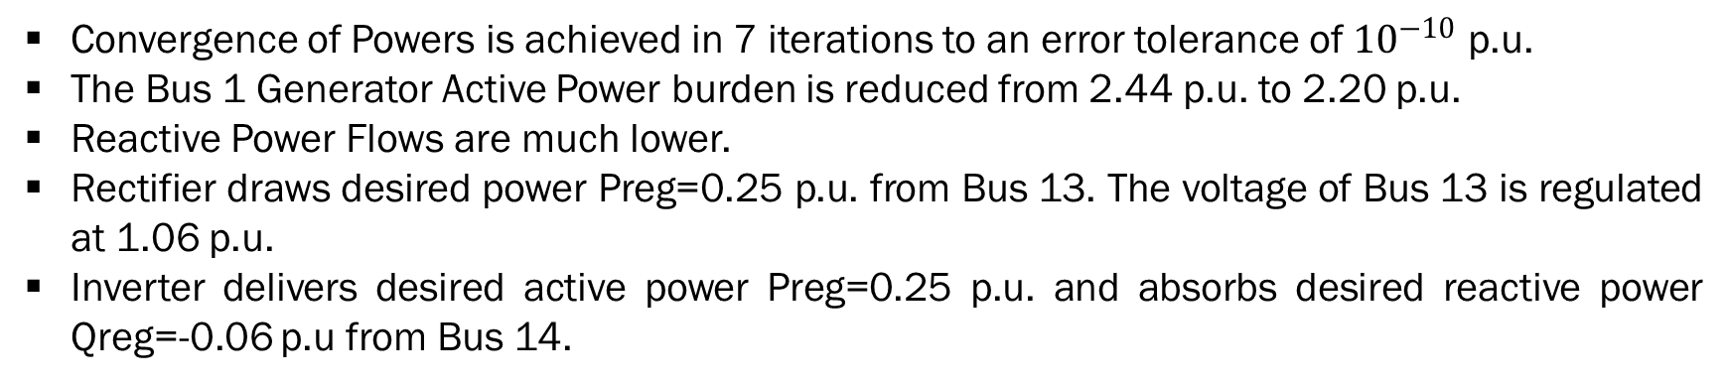
Convergence of Bus Voltages and Powers
Information | 1 | 2 | 3 | 4 | 5 | 6 | 7 | 8 | 9 | 10 | 11 | 12 | 13 | 14 | Rectifier | Inverter
|V| (p.u.) | 1.060 | 1.060 | 1.060 | 1.048 | 1.048 | 1.060 | 1.034 | 1.060 | 1.011 | 1.013 | 1.033 | 1.056 | 1.060 | 0.965 | 1.060 | 1.007
Θ (degrees) | 0.00 | -5.85 | -14.8 | -12.1 | -10.6 | -18.1 | -14.7 | -14.7 | -16.1 | -17.0 | -17.8 | -20.3 | -21.5 | -13.9 | -21.6 | -13.2
P (p.u.) | 2.20 | 0.183 | -0.942 | -0.478 | -0.076 | -0.112 | 0 | 0 | -0.295 | -0.090 | -0.035 | -0.061 | -0.135 | -0.149 | -0.250 | 0.250
ΔP (p.u.) |  | -8e-10 | -1e-9 | 1e-9 | -6e-10 | -2e-5 | -6e-9 | -1e-9 | 2e-9 | 5e-10 | 6e-10 | -4e-6 | 1e-5 | -3e-7 | 2e-5 | 1e-7
Q (p.u.) | 0.126 | 0.182 | 0.080 | 0.039 | -0.016 | 0.195 | 0 | 0.157 | -0.166 | -0.058 | -0.018 | -0.018 | 0.020 | -0.050 | 0.0003 | -0.060
ΔQ (p.u.) |  | 0.211 | 0.270 | 1e-9 | 1e-8 | -0.291 | 1.5e-7 | -0.116 | -2e-8 | -9e-9 | 4e-8 | 2e-4 | -0.01 | -8e-8 | -2e-4 | -1e-8
Convergence of Powers is achieved in 7 iterations to an error tolerance of ${10}^{−10}$ p.u.
The Bus 1 Generator Active Power burden is reduced from 2.44 p.u. to 2.20 p.u.
Reactive Power Flows are much lower.
Rectifier draws desired power Preg=0.25 p.u. from Bus 13. The voltage of Bus 13 is regulated at 1.06 p.u.
Inverter delivers desired active power Preg=0.25 p.u. and absorbs desired reactive power Qreg=-0.06 p.u from Bus 14.

Slide 22
Convergence of Bus Voltages and Powers

Slide 23
Regulated VSC Active and Reactive Powers

Slide 24
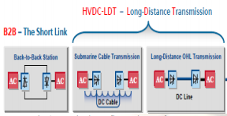
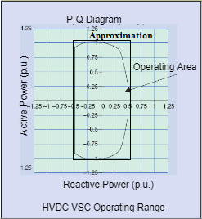
New HVDC Light Model
The New HVDC Light Model is different from the Book HVDC Light Model in that the Converters are connected using DC cables which contribute to active power loss. The loss is dependent on the constant DC voltage level and DC cable resistance.
Furthermore, the VSCs have a well-defined P-Q Diagram like the Generators and Synchronous Condensers. These graphs limit their operation and ability to regulate active and reactive power.

Slide 25
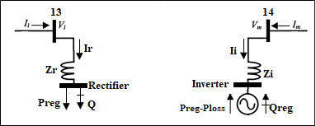
IEEE 14 Bus System with New HVDC Light Model
Rectifier is connected to bus 13 using Zr. Rectifier is modeled as a PQ node to draw desired power Preg=0.25 p.u. from Lake. The voltage of bus 13 is regulated at 1.06 p.u.
Inverter is connected to bus 14 using Zi. Inverter is modeled as a PV node to absorb desired reactive power Qreg=-0.06 p.u.
Power Ploss is lost between Rectifier and Inverter due to the DC cable.

Slide 26
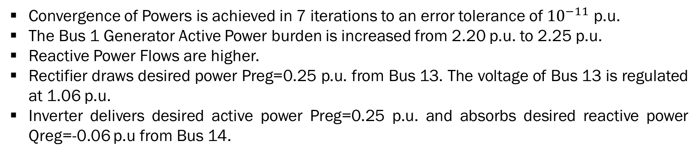
Convergence of Bus Voltages and Powers
Information | 1 | 2 | 3 | 4 | 5 | 6 | 7 | 8 | 9 | 10 | 11 | 12 | 13 | 14 | Rectifier | Inverter
|V| (p.u.) | 1.060 | 1.060 | 1.060 | 1.048 | 1.049 | 1.060 | 1.034 | 1.060 | 1.011 | 1.013 | 1.033 | 1.056 | 1.060 | 0.965 | 1.060 | 0.999
Θ (degrees) | 0.00 | -5.97 | -15.1 | -12.5 | -10.9 | -18.5 | -15.3 | -15.2 | -16.8 | -17.7 | -18.3 | -20.7 | -21.9 | -15.8 | -21.9 | -15.0
P (p.u.) | 2.25 | 0.183 | -0.942 | -0.478 | -0.076 | -0.112 | 0 | 0 | -0.295 | -0.090 | -0.035 | -0.061 | -0.135 | -0.149 | -0.250 | 0.200
ΔP (p.u.) |  | -1e-9 | 3e-10 | 4e-9 | -1e-10 | -2e-4 | -5e-9 | -9e-10 | -9e-11 | 3e-10 | 4e-10 | -3e-5 | 8e-5 | -2e-7 | 1e-4 | 1e-7
Q (p.u.) | 0.133 | 0.192 | 0.083 | 0.039 | -0.016 | 0.198 | 0 | 0.158 | -0.166 | -0.058 | -0.018 | -0.018 | 0.020 | -0.050 | 0.0003 | -0.060
ΔQ (p.u.) |  | 0.105 | 0.039 | 5e-8 | 2e-9 | -0.151 | 1e-7 | 0.016 | -2e-8 | -1e-8 | 3e-8 | 0.002 | -0.078 | -7e-8 | -2e-4 | 7e-9
Convergence of Powers is achieved in 7 iterations to an error tolerance of ${10}^{−11}$ p.u.
The Bus 1 Generator Active Power burden is increased from 2.20 p.u. to 2.25 p.u.
Reactive Power Flows are higher.
Rectifier draws desired power Preg=0.25 p.u. from Bus 13. The voltage of Bus 13 is regulated at 1.06 p.u.
Inverter delivers desired active power Preg=0.25 p.u. and absorbs desired reactive power Qreg=-0.06 p.u from Bus 14.

Slide 27
Convergence of Bus Voltages and Powers

Slide 28
Regulated VSC Active and Reactive Powers

Slide 29
Conclusion
Book HVDC Light Model
Compared to IEEE 14 Bus base case, the Generator and synchronous condenser Active Power burdens were reduced. Reactive Power Flows were much lower. Rectifier extracted desired power Preg=0.25 p.u. from Bus 13. Inverter absorbed desired reactive power Qreg=-0.06 p.u from Bus 14.
New HVDC Light Model
The New HVDC Light Model Converters are connected using DC cables which contribute to active power loss. Furthermore, the VSCs have a well-defined P-Q Diagram like the Generators and Synchronous Condensers.
It regulated desired Active and Reactive Powers. The Generator and Synchronous Condenser Active Power burdens were slightly higher. Also, Reactive Power Flows were higher compared to Book HVDC Light Model.

Slide 30
References
http://labs.ece.uw.edu/pstca/pf14/pg_tca14bus.htm
A. K. Mohanty and A. K. Barik, “Hvdc light and facts technology: A modern approach to power system interconnections,” International Journal of Engineering Research and Applications (IJERA) Vol, vol. 2, pp. 1331–1336b.
M. Barnes and A. Beddard, “Voltage Source Converter HVDC Links – The state of the Art and Issues Going Forward”, Energy Procedia, vol. 24, 2012, pp. 108–122.
R. Sellick and M. Akerberg, “Comparison of HVDC Light (VSC) and HVDC Classic (LCC) Site Aspects, for a 500MW 400kV HVDC Transmission Scheme”, 10th IET International Conference on AC and DC Power Transmission (ACDC 2012), pp. 1-7.
M.Callavik et al., “ENERGY TRANSITION Evolution of HVDC Light”, ABB Review 2018, pp. 1-8.
S. Mukherjee at al., “Cable Overvoltage for MMC based VSC HVDC System: Interaction with Converters”, CIGRE Study Committee B1 Meeting and International Colloquium, New Delhi, India, 2017, pp. 1-9.
E. Acha, V. Agelidis, O. Anaya, and T. J. E. Miller, Power electronic control in electrical systems. Elsevier, 2001.
A. Hassanpoor et al., “Cost-Effective Solutions for Handling Dc Faults in VSC HVDC Transmission”, EPE2016, Karlsruhe, Germany, 2016, pp. 1-7.
V. Donde et al., “Distributed State Estimation of Hybrid AC/HVDC Grids by Network Decomposition”, IEEE Transactions on SMART Grid, March 2016, Vol. 7, pp. 1-9.
P. Lundberg et al., “VSC HVDC Transmission Supporting Variable Electricity Generation”, The International Council on Large Electric Systems, 2016, pp. 1-9.

